Slide 1
Relational Database Operations(1)
Can be categorized into two groups:
Updates
  Insert
  Modify
  Delete
  All update operations must satisfy all
  constraints (entity integrity, referential integrity
  and enterprise constraints)

Slide 2
Relational Database Operations(2)
Retrievals
  Relational Algebra operations are used to specify retrievals
Relational algebra operations include:
  SELECT operation
  PROJECT operation
  Set theoretic operations
  JOIN Operation

Slide 3
INSERT Operation(1)
Used to insert a new tuple or tuples in a relation
Provides a list of attribute values for a new tuple
Insert can violate any of four types of constraints

Slide 4
INSERT Operation(2)
Domain constraint can be violated
  value of some attribute does not appear in its domain
Key constraint can be violated
  Key value of the tuple already exists in another tuple as its key value
Entity integrity constraint can be violated
  Key value of tuple is null
Referential integrity constraint can be violated
  Some foreign key value of tuple does not exist in the references relation

Slide 5
DELETE Operation
Used to delete a tuple or tuples from a relation
It can violate only referential integrity
  If tuple being deleted is referenced by the foreign keys from other tuples in the database

Slide 6
MODIFY/UPDATE Operation
Used to change the values of one or more attributes in a tuple or tuples of a relation
Like INSERT operation all four constraints can be violated by UPDATE operation

Slide 7
Relational Algebra Operations(1)
Enable user to specify basic retrieval requests
Result of a retrieval is a new relation

Slide 8
Relational Algebra Operations(2)
SELECT operation
PROJECT operation
Set theoretic operations
  UNION, DIFFERENCE, INTERSECTION and CARTESION PRODUCT
JOIN Operation
  EQUI JOIN, NATURAL JOIN, INNER JOIN, OUTER JOIN, SELF JOIN

Slide 9
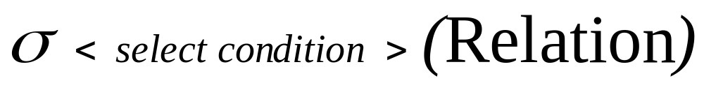
SELECT Operation(1)
Used to select a subset of tuples from a relation that satisfy a selection condition
In other words SELECT operation can be considered as a filter that keeps only those tuples which satisfy a qualifying condition
Here sigma denote select operator
Select condition is the boolean expression specified on the attributes or relation
Relation is either itself a relation or another select/project operation which results a relation

Slide 10
SELECT Operation(2)
The resulting relation has the same attributes as the original relation.

Slide 11
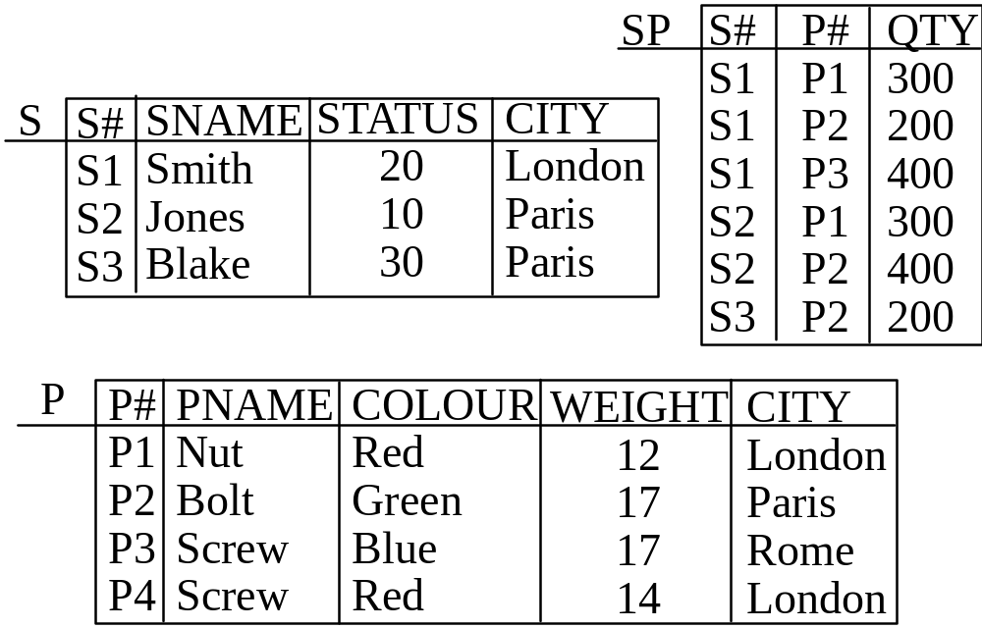
Example Database

Slide 12
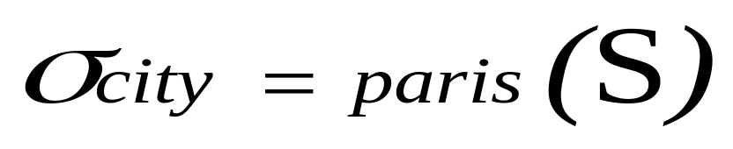
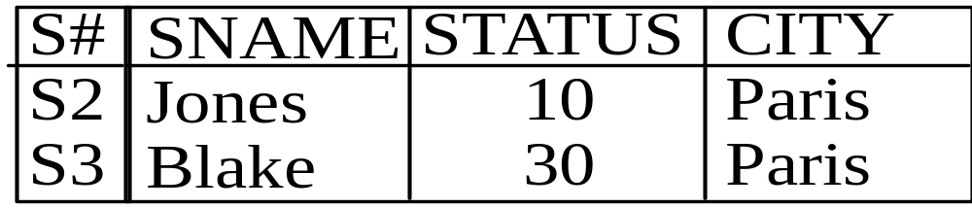

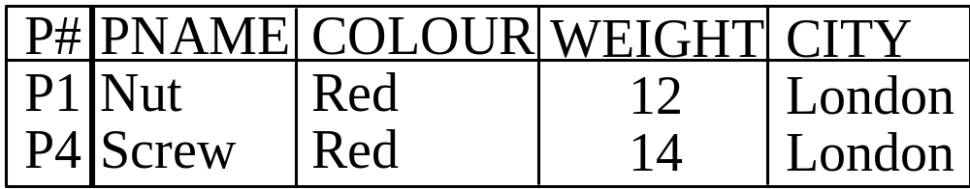
SELECT Operation(3)

Slide 13
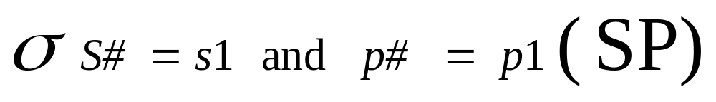
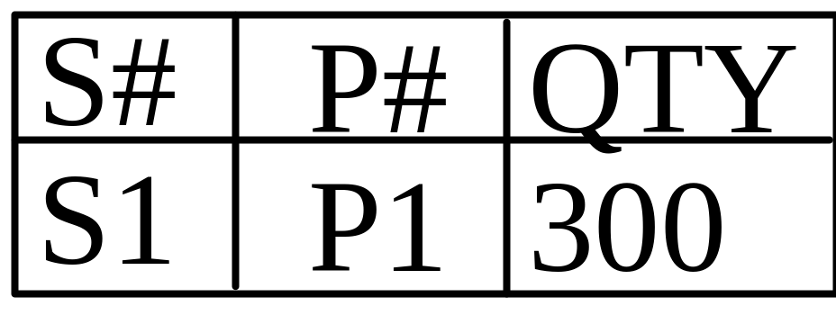
SELECT Operation(4)

Slide 14
PROJECT Operation(1)
PROJECT operations selects certain columns from a relation and discards other columns and hence constructs a vertical subset of a relation
When we are interested in only certain attributes of a relation we use PROJECT operation

Slide 15
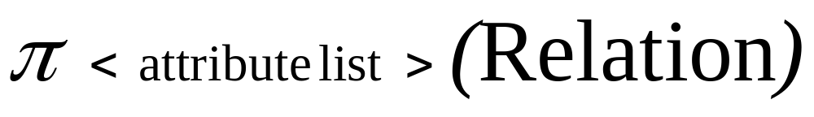
PROJECT Operation(2)
Here pi denote project operator
Attribute list is list of attributes to be projected
Relation is either itself a relation or another select/project operation which results a relation

Slide 16
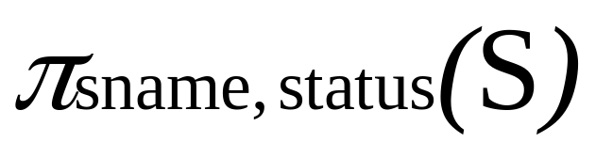
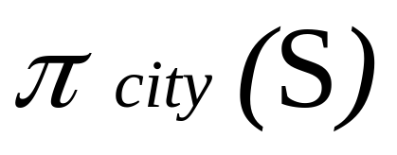
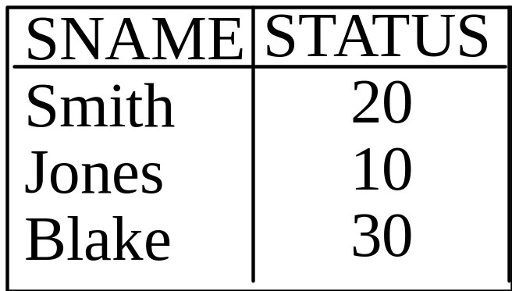

PROJECT Operation(2)

Slide 17
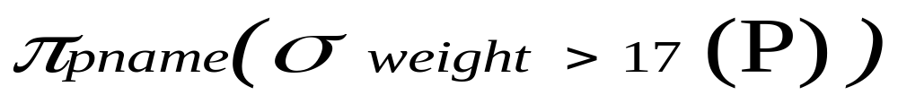
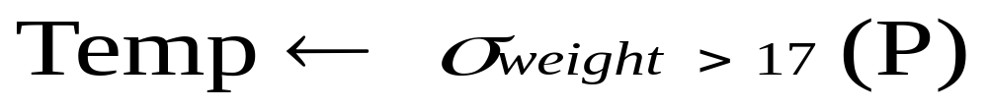
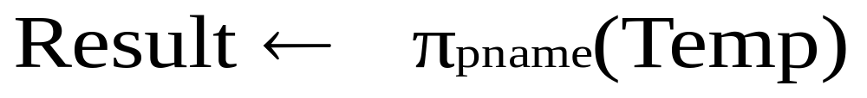
Sequences of operations
Many operations can be performed in sequence in one expression. For example you want part names where part weight is less than 17.
Both operations can be written seperately

Slide 18
Set Theoretic Operations
UNION, DIFFERENCE, INTERSECTION binary operations - they take two relations
The two relations must be union-compatible i.e same degree and matching domains (ith column of first relation and ith column of second relation have same domain)

Slide 19
UNION Operation
Denoted by RUS
Results in a relation that includes all tuples that are either in R or S or in both R and S
It is commutative i.e. RUS=SUR

Slide 20
INTERSECTION Operation
Denoted by R∩S
Results in a relation that includes all tuples that are both in R and S
It is commutative i.e. R∩S =S∩R

Slide 21
DIFFERENCE Operation
Denoted by R-S
R-S is a relation that includes all tuples that are in R but not in S
It is not commutative

Slide 22
CARTESION PRODUCT
Cartesion product of R and S is denoted by RxS
Also known as Cross Product or Cross join
In R x S each row of S is paired with each row of R
If there are m rows in R and n Rows then there will be m*n rows in RxS
If there are a attributes in R and b attributes in S then there are a+b attributes in RxS

Slide 23
CARTESION PRODUCT(1)
What will be the result of cartesion product of S and SP table?

Slide 24
JOIN Operation
JOIN operation used to combine related tuples from two relations into a single tuple
Very important operation: allows to process relationships among relations

Slide 25
JOIN Operation Example(1)
Consider employee and department relations of an organization
Employee
Department
EID | ENAME
1000 | Naveed
1001 | Anees
1002 | Khurram
1003 | Asim
1004 | Mohsin
DID | DNAME | MGRID
101 | Accounts | 1000
102 | Development | 1001
103 | Research | 1001
104 | Management | 1000
105 | Academics | 1004

Slide 26
JOIN Operation Example(2)
Now suppose we want to retrieve the name of manager of each department
We need to combine each department tuple with the employee tuple whose EID matches with the MGRID in department tuple

Slide 27
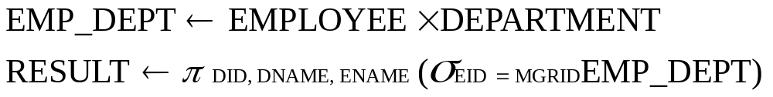
JOIN Operation Example(3)
We can do it in two ways
We can simply use cartesion product first and then project required attributes

Slide 28
JOIN Operation Example(4)
We can use JOIN operation (More common way)

Slide 29
JOIN Operation Example(5)
Result of both methods will be:
Result
DID | DNAME | MGRNAME
101 | Accounts | Naveed
102 | Development | Anees
103 | Research | Anees
104 | Management | Naveed
105 | Academics | Mohsin

Slide 30
JOIN and Caresion Product
Each tuple of result of JOIN is combination of one tuple from both relations
Then what is difference between JOIN and Cartesion Product?
Cartesion product is combniation of each row of first relation with each row of second relation
In join only those combinations are included which satisfy the join condition

Slide 31
JOIN Condition and Theta Join
General join conditions is of the form:
  <condition> and <condition> …..<condition>
  Where each condition is of the form Ai Ө Aj
  Ai and Aj are attributes of first and second relation respectively
  Ai and Aj have same domain
  And Ө may be any comparison operator (<,>,=,<=,>=,<>)

Slide 32
EQUI JOIN
Most common join involves join condition with equality comparisons only
Such join is called EQUI JOIN

Slide 33
Join Cont….

